Slide 1
Prompt Engineering and Context Engineering
How to sucessfully ask the Ai
John Ballesteros

Slide 2
Iterative Prompt Engineering
It starts with a clear, specific prompt (e.g., “Retrieve X posts on AI ethics, in 2025, excluding opinions”) to optimize DeepSearch’s real-time data access.

Slide 3
Meta Prompting
It is the process of recurring asking a LLM on how is the best way to ask it for obtaining specific results, ex. “Write me the best prompt to retrieve X posts on AI ethics, in 2025, excluding opinions”

Slide 4
Context Engineering
Providing relevant background information to effectively get the best possible results :
Setting role definitions ("You are an expert in...")
Establishing the appropriate tone and style, behavioral guidelines, constraints and boundaries, output format requirements
Providing relevant background information and examples
CoT: Encouraging step-by-step reasoning, breaking complex problems into stages, making the model's reasoning process explicit

Slide 5
LLM Use Modes
DeepSearch or DeepResearch: iteratively searches the web to provide accurate, current responses.
Think, Plan or Reasoning: enables deliberate reasoning, enhancing accuracy for complex tasks, unlike standard response modes.

Slide 6
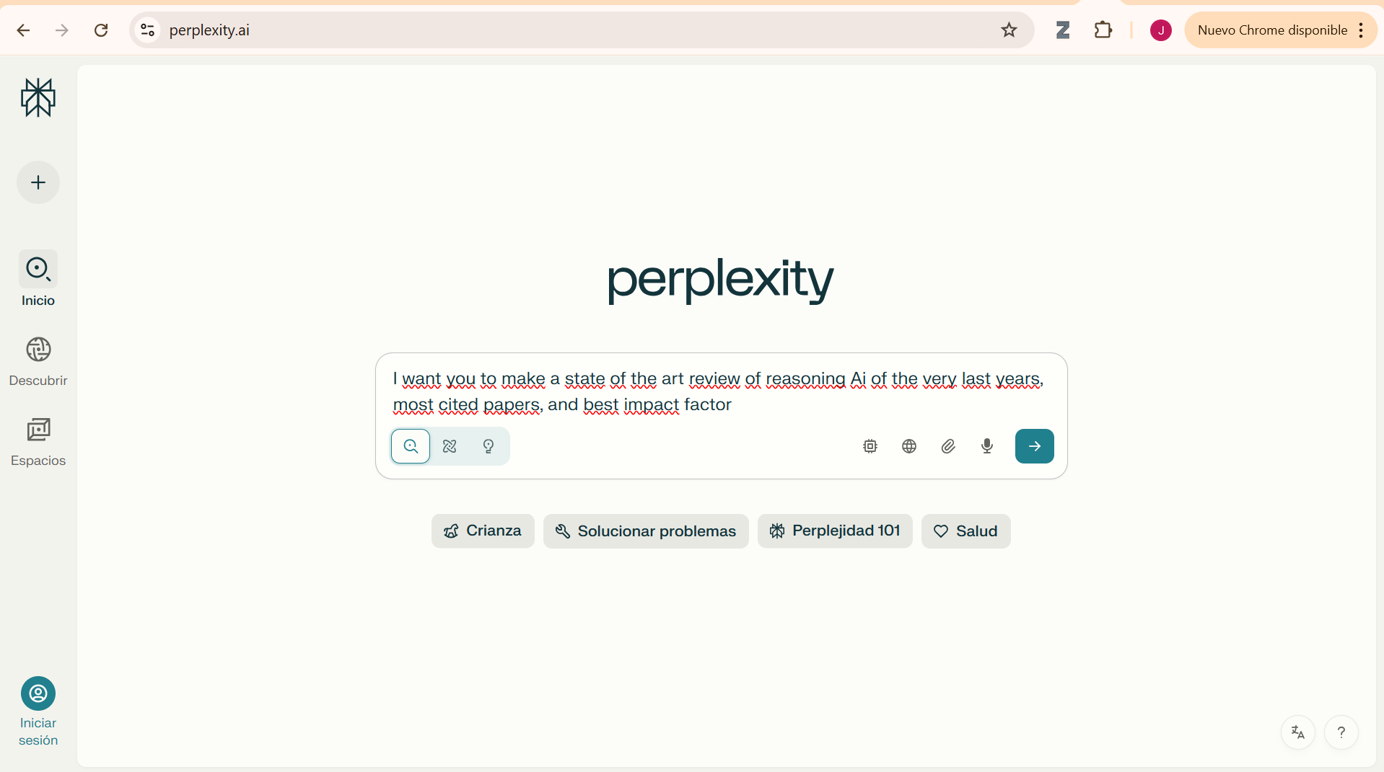

Slide 7
Optimization and Reasoning LLMs
Lowering computing power and memory and improving efficiency

Slide 8
Retrieval Augmented Generation (RAG)
It’s designed to improve LLM outputs (less hallucinations) allowing them to use up to date and authorized information.
Retrieves information from additional sources (DB, Internet)
Use it as additional context (augment)
Generates the output with the provided info in mind.

Slide 9
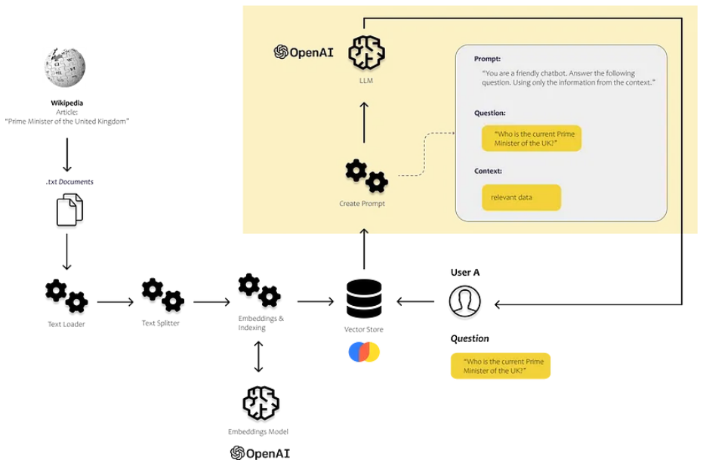
OpenAi, Technical Guide, 2024

Slide 10
Quantization
Used to reduce the size of the model file (up to 50%) and the inference time (miliseconds), it is done by changing
During Training: more complex and extra dataset is needed
Post Training: once the model is created, it is the conversion of numbers precision from fp32, to INT8 or even 4bit.

Slide 11
Pruning
Reduces the size of the model by eliminating neurons, attention heads, convolutions kernels, and even entire layers, based on their importance. It can reduce from 8B to 4B, Microsoft’s Phi models are examples (SLM).
It is used in tandem with the Knowledge Destillation technique.

Slide 12
Destillation (KD)
Use knowledge transfer from a larger and precise model (Master) to a smaller and simpler model (Student).
The student is forced to imitate the output and intermediate state of the master by minimizing the Kullback-Lieber divergence between them in the logits (un-normalized values).

Slide 13
Reinforcement Learning, RLAIF and RLHF
They seek to align LLM responses to human preferences and improve performance of LLMs.
AIF or HF compare and choose from different outputs of a model training a new Rmodel that gives a higher scalar value to beter answers. These values are used to fit the initial model in a way to maximize the rewards by the Proximal Policy Optimization (PPO).

Slide 14
From Gen AI to AgenticAi to AGI
Silicon Valley’s Tech Companies Diverse Perspectives on AI
John Ballesteros
jballes@unal.edu.co

Slide 15
Introduction
Explore the AI strategies of Apple, Meta, Nvidia, Google, and OpenAI, highlighting skepticism, ambition, and innovation.
Understanding these perspectives shapes our view of AI’s future, risks, and societal impact.

Slide 16
Apple: Skeptical and Cautious
Apple is “enemy” of overhyped AI claims, particularly AGI via large language models (LLMs).
Approach: Focuses on efficient, practical AI (e.g., OpenELM, a small open-source model).
Prioritizes privacy and on-device AI (e.g., Apple Intelligence).
Advocating for grounded, user-centric AI solutions.

Slide 17
The Illusion of Thinking, Apple, 2025
The study by Apple revealed that reasoning models (e.g., OpenAI’s o3, Meta’s Claude) suffer “complete accuracy collapse” on complex tasks, relying on pattern recognition rather than true reasoning.
“Reasoning models don’t show generalized reasoning; their performance falls apart on complex tasks.”

Slide 18
Meta: Pursuing Superintelligence with Skepticism on LLMs
Meta is ambitious about superintelligence but doubts LLMs alone can achieve AGI or human-level intelligence.
Meta’s Chief AI Scientist, Yann LeCun, criticizes LLMs as “intrinsically unsafe” and limited in logic, memory, and world understanding.
Meta launched a Superintelligence Lab, offering massive compensation (up to $100M) to attract top researchers.
Llama 4 underperformed compared to OpenAI/Google, prompting a shift to ambitious projects.

Slide 19
Meta aims for transformative AI but rejects the LLM scaling paradigm, aligning with academic skepticism.
Developing new AI architectures beyond LLMs, focusing on “common sense” and world models.
“We’re never going to reach human intelligence by training AI on text alone.” — Yann LeCun, 2025
JEPA I, Meta Ai, 2023
V-JEPA 2, Meta Ai, 2025

Slide 20
Nvidia: Enabling AI with World Models
Nvidia supports the AI ecosystem by developing infrastructure and tools, including generative world models for robotics.
CEO Jensen Huang unveiled Cosmos, a platform for creating virtual worlds to train robots, reducing costs and risks.
Nvidia’s GPUs (e.g., H100, RTX 5090) power most AI training, making it a critical enabler.
Supplies chips for AI models (e.g., Meta’s Llama trained on 16,000 Nvidia A100 GPUs).

Slide 21
Predicts AI surpassing human test performance within 5 years, focusing on practical applications.
Nvidia’s world models and hardware accelerate AI innovation, but it remains agnostic on AGI timelines.
Food is information that can be printed in the near future, solving out major inefficiencies of grow and harvesting.
“Cosmos generates synthetic data for training physical AI like robots.” — Jensen Huang, CES 2025

Slide 22
Google: Racing Toward AGI with Transformers
Google DeepMind is aggressively pursuing AGI, viewing it as a near-term goal (potentially by 2030).
CEO Demis Hassabis predicts AGI within a decade, driven by transformer-based LLMs and reasoning models.
Developing Gemini as a “full world model” for agentic AI that plans and acts across devices.
Investing in generative world models and agentic coding systems for scientific breakthroughs.
“The final race to AGI is afoot; we must turbocharge our efforts.” — Sergey Brin, 2025

Slide 23
OpenAI: Leading the AGI Charge with LLMs
OpenAI is confident in achieving AGI soon, transitioning to superintelligence via LLMs and reasoning models.
CEO Sam Altman claims OpenAI knows how to build superintelligent AI, predicting AGI by 2029.
Released o1, a reasoning model that “thinks” before responding, improving complex task performance.
Scaling LLMs with massive data and compute (e.g., GPT-4.5/Orion).

Slide 24
Collaborating with Broadcom for custom AI chips to reduce Nvidia dependency.
AI consumes vast energy and compute (e.g., OpenAI’s Stargate Project needs power for 3M homes).
Data scarcity looms as internet text is exhausted, pushing reliance on synthetic data.
OpenAI’s aggressive push raises ethical and safety concerns, with critics noting lax security and misalignment risks.
“AGI will massively accelerate scientific discovery, however, singularity is not a point but different separate moments.” — Sam Altman, 2025

Slide 25
xAi
Emphasizes “maximally truth-seeking” AI, avoiding “politically correct” biases in LLMs.
Integrates with Tesla (autonomous driving) and X (data training), leveraging Musk’s ecosystem.
Advocates “maximally curious” AI that seeks truth over ideological biases, criticizing “woke” AI systems.
Estimates a 10–20% chance AI could “go bad,” posing a “significant existential threat” to humanity. Warns of “civilizational destruction” if AI develops unchecked, misuse for bioweapons.

Slide 26
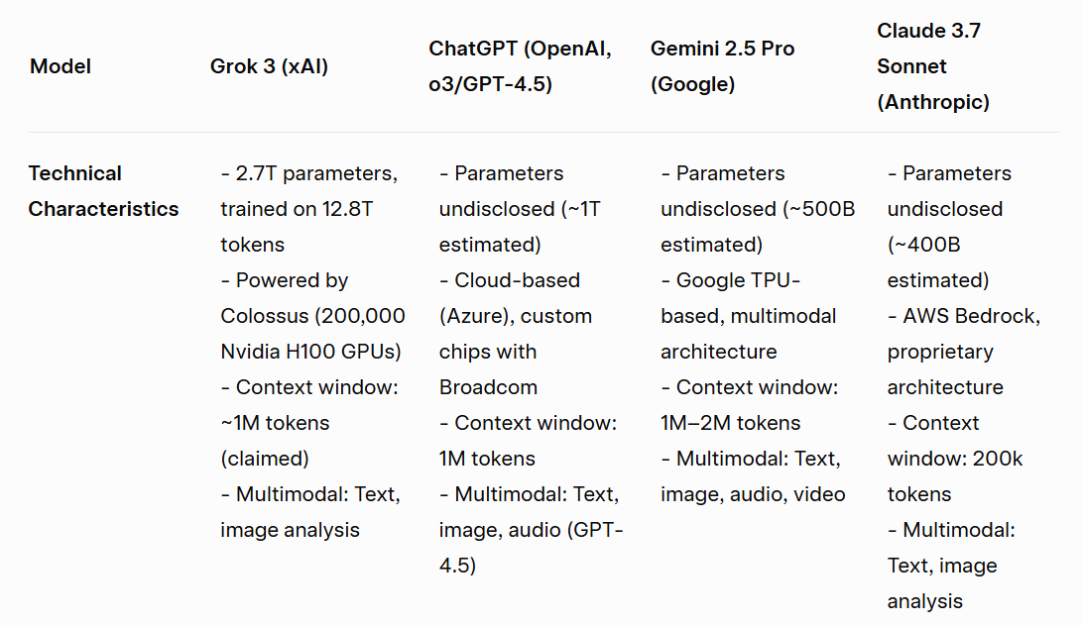

Slide 27
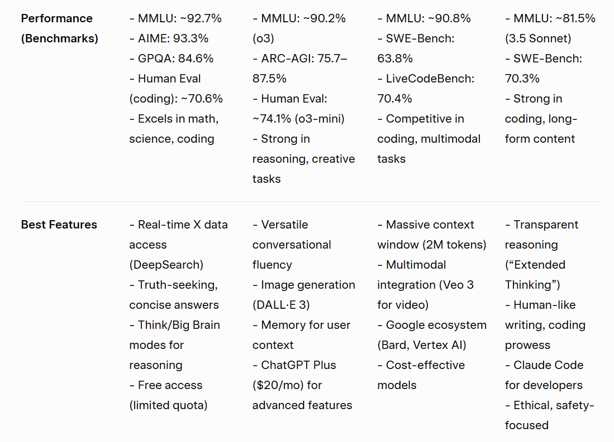

Slide 28
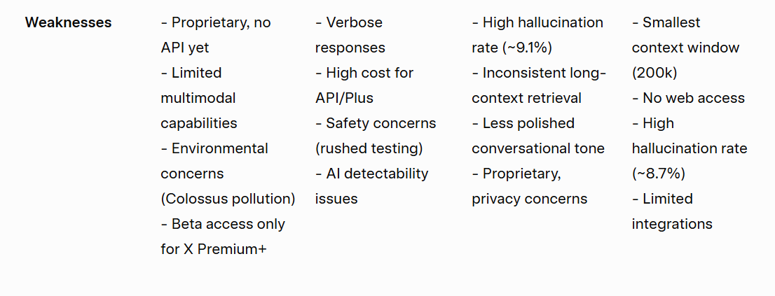

Slide 29
Anthrop|c: Focus on Security of Ai
Adolescense of Technology
Confronting and Overcoming the Risks of Powerful AI,
Dario Amodei, CEO Anthropic, January 2026
This paper provides the first empirical example of a model engaging in alignment faking without being trained to do so

